Slide 1
GIT GUD
How NOT to branch off to the wind

Slide 2
Git 2005
Linus created Git for the development of Linux
every git repository is a complete repository.
with complete history and full version-tracking abilities
independent of network access or a central server

Slide 3
Git why
It enables non linear development, by multiple developer at the same time
Also a online storage for yourself if you wants your files never be deleted from the history if internet

Slide 4
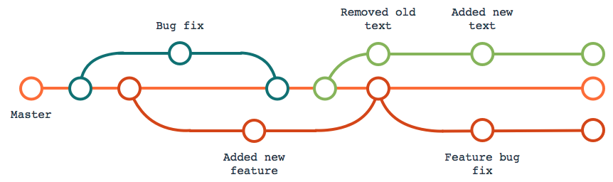
Git what

Slide 5
Git what
Repository: a place to keep history of any documents
Branches: a place to add stuff without affecting others
Commit: add snapshot of the documents to the history
Merge: Combing content of two branches into one
Merge conflict: we all know and hate when it happens

Slide 6
Git more on merge conflict
Cause of merge conflict:
When merging competing commits
Imagen you decided to go on a date, you wanted movie and your partner wanted arcade. Now you are stuck for eternality.
This is how Git do.

Slide 7
Git not to get conflict
Commit in small increment, more frequently
Keep branches short lived

Slide 8
Git accurate representation

Slide 9
Git resolve merge conflict
Now we are stuck in eternal flame, or are we?
There are two options, but both are painful
First: manually read through the code and merge it by hand
The bigger the commit, the more you need to read!

Slide 10
Git commit –m ”suic… suck it up”
To resolve conflict we can also abort all local changes, or abort other’s changes
This will brings you to the last working copy with no conflict.
Conflict is gone, but you either hate yourself, or your teammate will hate you for life

Slide 11

Git --force
Git merge featureBranch --force
The featureBranch essentially becomes the master branch.
It might ended up with half broken branch.
Avoid if possible

Slide 12
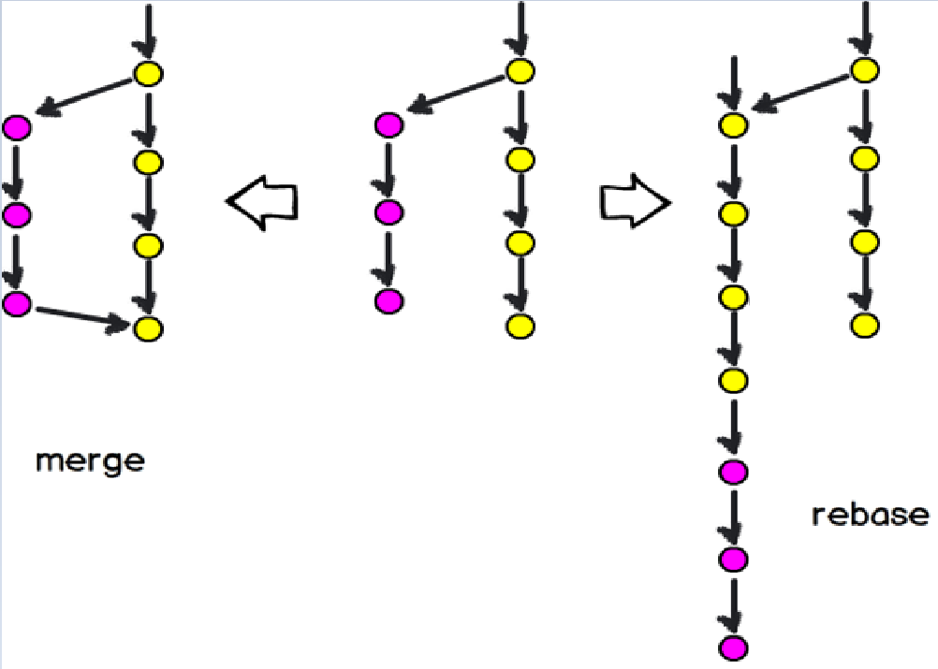
Git merge vs Git rebase

Slide 13
Git rebase
Similar to merge in a way that it helps getting commit into one branch
It moves the last common commit to the latest on the target branch

Slide 14
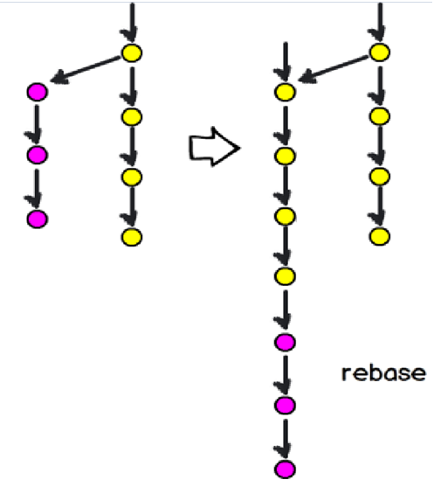
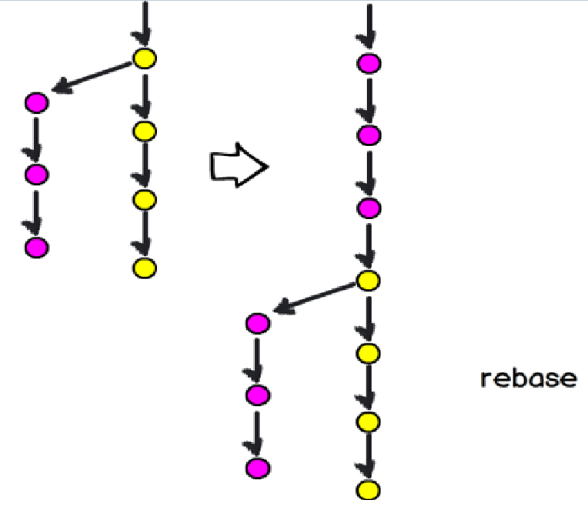
Git rebase warnings
Do not rebase a public branch. You put your own commit on to you own master while other developer do.

Slide 15
Git your hands on git
(Windows) https://gitforwindows.org
Install git at the provided website

Slide 16
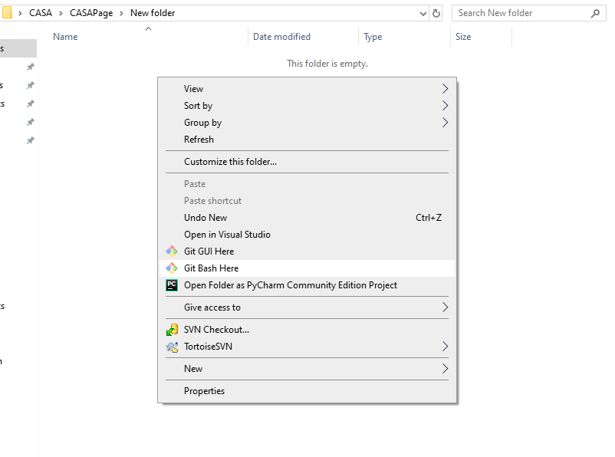
Create a local repo
On a empty folder, right click and select “Git Bash Here”

Slide 17

Get your own repo on your computer
Input command : git init
You now should be able to see a file named .git

Slide 18
Add a remote
git remote add “name” “repo location”
Name here is origin
Location:
https://UH-EIT-CW@dev.azure.com/UH-EIT-CW/
WorkshopsAndTutorials/_git/WorkshopsAndTutorials

Slide 19

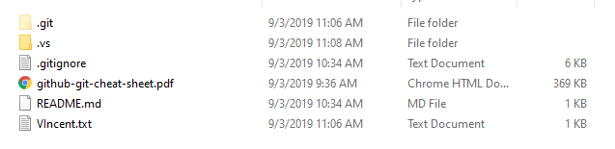
Get what is on the repo
git pull “remote” “branch”
Your folder should look like this (a little different depends on me add/remove stuff)

Slide 20


Lets do a commit
Create a .txt file, name it whatever you want
git add file name (this will track the file)
git commit –m ”meaningfull message” (commit to local repo)

Slide 21
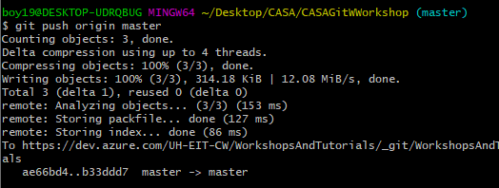
Now PUSH!
git push “remote” “branch” (now everyone can see the changes you made)

Slide 22

Now PULL!
git pull (get others changes to your repo)

Slide 23
Yup, I know this is happening
By now some of you should see error staying that your repo is few commit behind the repository, and you need a pull.
git pull

Slide 24
Conflict time
Follow the instruction to get a conflict
I am going to add to one of the files, and only one of you need to make changes to the same file (I don’t want to make it a disaster ☺)
Maybe I will demonstrate on my computer

Slide 25
Remember
Conflicts are hard to deal with, avoid if possible
Git cheat sheet are available in the repo that we just pulled, it will be useful in the future

